Slide 1
Delivering products, evolving platforms
Aligning project delivery and platform evolution for complex systems

Slide 2




Presenters
Dr. Alba Pennisi
Head of Business Lines Architecture
Belimo Automation AG
Johannes Krautkremer, M.Sc.
Senior Consultant MBSE
:em engineering methods AG

Slide 3
Growing Complexity in System Development
Multiple domains, different rhythms, increasing coordination effort
Mechanical, electronic, and software integration difficult due to different development cycles per domain
Increasing pressure from markets for fast delivery of new/additional products
Software-heavy systems require long-term reuse of assets, e.g. a stable hardware platform for software-deliveries
High coordination overhead due to different timelines for development
The need for platform development seems evident!
Mechanics
Integrate
System Delivery
Electronics
0100
0001
1010…
Software

Slide 4
Confusing development approaches
Clarity of concepts needed
Delivery
Coming from a project-centric development approach, organizations often struggle developing platforms for their product portfolios.
Often confused concepts are:
Projects vs. platforms
Agile projects vs. milestone projects
Products vs. platforms
Let’s try to make the concepts and
their differences clear!
Agile
Projects
Milestones
Products
Product Line
Release
Platform

Slide 5
What - Project vs. Platform Thinking
Two fundamentally different perspectives on development
Projects:
focus on delivering a product
clearly define scope and timeline
Platforms:
focus on reusable capabilities
foster continuous evolution
They are not competing approaches to product development!

Slide 6
How - Agile projects vs. milestone projects
Content Definition
Content definition in Agile projects is more flexible than within milestone projects:
  Agile projects continuously define the content for the current/next delivery
  Milestone projects require a stable scope and often end with a single delivery
A single Agile delivery will not provide all content at once, but they deliver more often than a milestone project
Defining scope at the beginning of a project without possibility to adapt is not suitable for investigating new technologies!

Slide 7
How - Agile projects vs. milestone projects
Delivery of capabilities
Capabilities of a delivered project result are fixed at the start of a milestone project, due to fixed scope
Agile projects add to the capability of the delivered result continuously due to continuous adaption of scope based on the current delivery
Agile projects often require multiple iterations to reach the same capabilities as scoped for a milestone project

Slide 8
What and How is developed?
Two independent but interacting dimensions
What is developed?
  Project delivery
  Platform delivery
  Product delivery?
How is it developed?
  Milestone planning (“traditional”)
  Agile continuous delivery
Agile
Continuous Platform Development
Long-lived platform capability base
Enables Product Line Engineering
Iterative Product Development
Delivers system/product instance
May contribute to platform evolution
Platform
Project
Structured Platform Integration
Continuous platform evolution
Alignment through stable interfaces
Planned System Delivery
Single, defined system/product
Scope defined upfront
Alignment through system releases
Milestones

Slide 9
Relation between organization and products
Conway‘s Law
„An organization's design of a system will mirror its internal communication structure“
The product structure initially creates the organizational structure to support product development through Processes, Methods and Tools PMT.
The organizational structure now supports and enforces the product development it was created for.
Organization
Product
Initial creation
Organization
Product
“formal way”

Slide 10
Relation between organization and products
Tension through misalignment
Changes in organizational structure must align with the developed product structure
Changes in product structure must align with the organizational structure
This is true for all types of changes, e.g.:
  Introduction of new processes, methods, tools
  Increased complexity of products
  Adoption of Agile methods
  Administrative re-organizations
Change contains always a mindset-change from old ways of work to new ones!
NEW org. structure
misaligns with
old product
Organization
Product
NEW product
misaligns with
old org. structure
Organization
Product

Slide 11
Consequences of a non-fitting mindset
Introduction of Platform development
When project-centric thinking remains after a formal switch to platform development:
Ownership of deliverables ends with projects
Fixed scope of a project more important than evolving needs of a platform
Interfaces optimized for short-term use, to solve immediate needs
Releases tied to milestones
All this results in limited reuse and high coordination efforts!
“Platform” Concept
System
Development
Platform maintenance?
System Delivery

Slide 12
Platform as capability space
How to ease the tension
Shift focus towards structural alignment!
Capability = The ability of a system to execute a particular course of action or achieve a desired effect, under a specified set of conditions
Platform = set of capabilities
Features define variability of products
Products = combinations of features
The platform evolves through products
A Platform provides the foundation for reuse
&
Projects help evolve the platform

Slide 13
Projects and Platforms must integrate
Complementary roles in development
Projects select and combine platform capabilities to create deliverable systems
Projects contribute to the evolution of the platforms capabilities
Platform ensures long-term consistency by integrating the evolved capabilities
A continuous improvement loop can be established!
Capability extension & refinement
Project integration
Select & combine capabilities
Platform capabilities
Delivered
system

Slide 14
Product delivery & stable structure
How to ease the tension
Separating Delivery and Evolution
Projects integrate and deliver products with a clear scope
Platform evolves capabilities continuously for projects to use
Ownership of capabilities extends beyond projects!
Temporal & structural synchronization
Defined capability boundaries provide a clear structure within the platform that enables platform evolution
Releases define synchronization points for different development rhythms
Projects handle system-level integration along releases within the capability boundaries
Temporal and structural cross-domain alignment is enabled!

Slide 15
Key Takeaways
Delivery
From Conflict to Synergy by mindset shift
Agile
Projects
Projects and platforms are complementary concepts to enable development of complex products and product lines
Problems come from misalignment of product-centric and platform mindsets
Alignment can be achieved through:
  A structured and governed platform
  Coordinated evolution of the capabilities of the platform
  Clear roles and responsibilities, separating delivery of products from and evolving capabilities of the platform
Milestones
Products
Product Line
Release
Platform
To sustain any evolving development organization, aligning product structures, organizational structures, and development approaches is required.

Slide 16
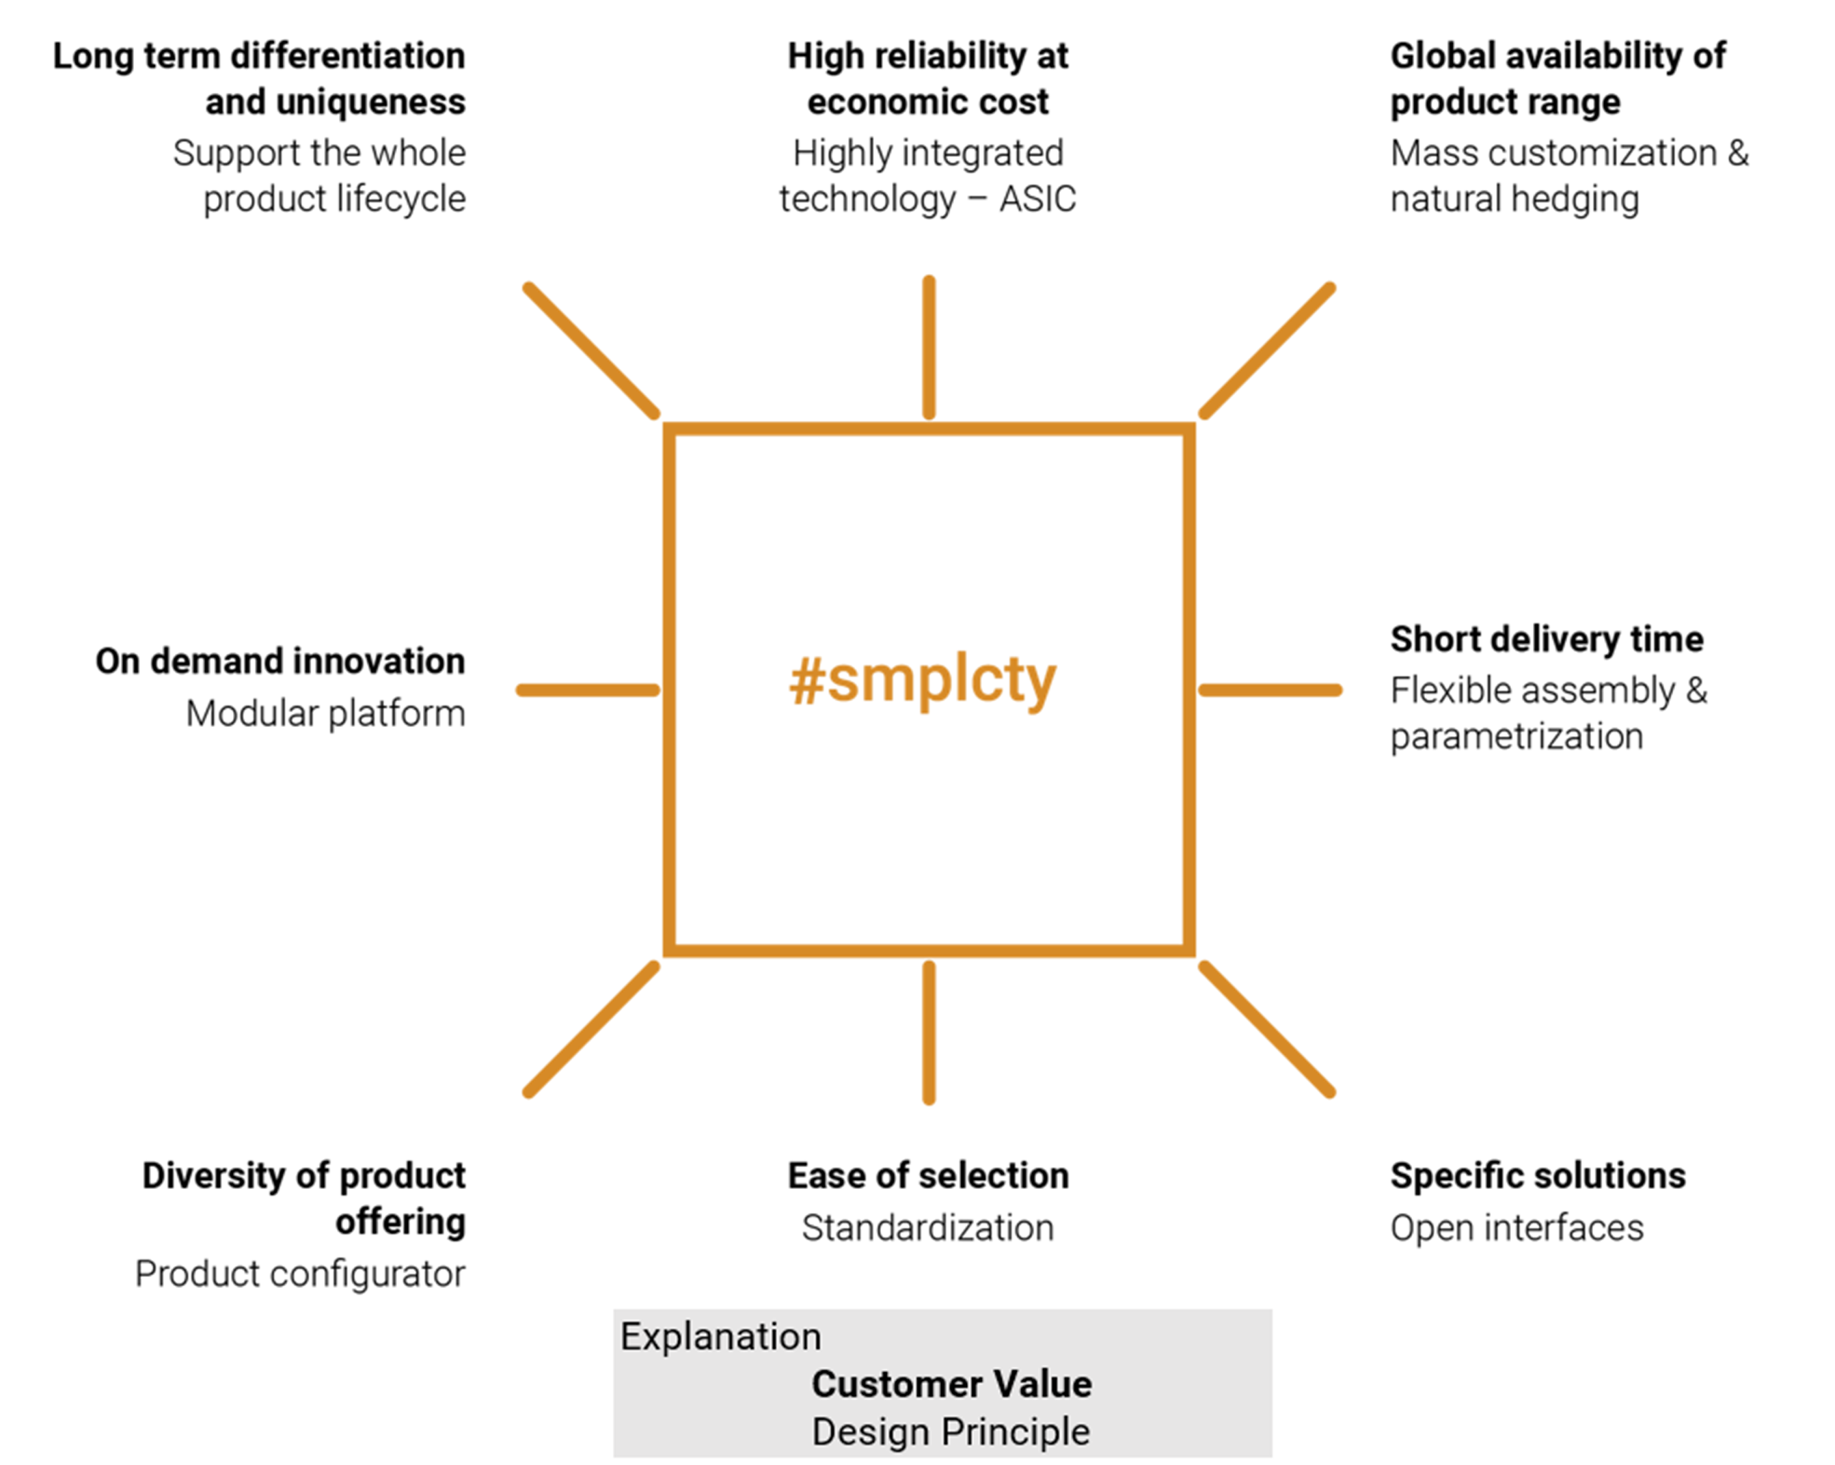
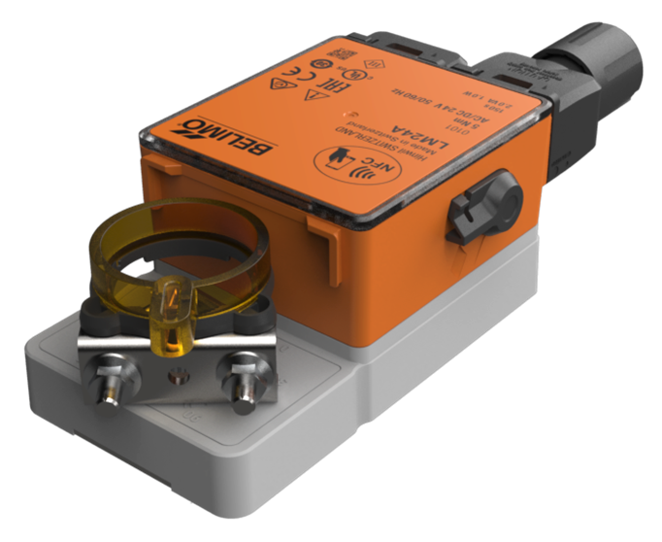
Industrial Experience
Belimo's Platform Transformation Journey.
Shared platform foundation
Agile and SAFe Principle
01
The smplcty program established reusable capabilities across products and generations, improving consistency and reducing development and maintenance effort.
Belimo adopted Agile practices and SAFe to support iterative platform development, rapid feedback, and continuous improvement.
02
Delivering Products
PCP Process
03
At its core, Belimo remains committed to delivering reliable products that meet customer needs.
The Product Creation Process (PCP) serves as Belimo’s overarching governance framework, providing milestone-based planning, cross-functional synchronization, and governance to ensure reliable delivery of cyber-physical products.
Hybrid operating model
Platforms evolve shared capabilities continuously, while complete cyber-physical products remain primarily delivered through
PCP-governed projects.
EMERGING TENSION
Long-term platform optimization ↔ product-specific scope, timelines and budgets

Slide 17
The Next Evolution
Towards requirements-driven platform operating model
Q1
Q2
Q3
Q4
PCP Project
(Product
Implementation)
Product
Release
Quarterly Release Cycles
Market
Product
Requirements
Harmonized
Requirements
Requirements Baseline Release
Common Requirements Baselines
Platform
Requirements
Platform Version Release
Single Version Implementations
Platform
Implementation
A consistent platform requires that all elements operate on aligned requirements at any point in time

Slide 18
Industrial Experience
Belimo's Platform Transformation Journey.
Shared platform foundation
Agile and SAFe Principle
01
The smplcty program established reusable capabilities across products and generations, improving consistency and reducing development and maintenance effort.
Belimo adopted Agile practices and SAFe to support iterative platform development, rapid feedback, and continuous improvement.
02
Delivering Products
PCP Process
03
At its core, Belimo remains committed to delivering reliable products that meet customer needs.
The Product Creation Process (PCP) serves as Belimo’s overarching governance framework, providing milestone-based planning, cross-functional synchronization, and governance to ensure reliable delivery of cyber-physical products.
Release of tension: Product-centric (pre-SMPlicity) → Platform-enabled (SMPlicity + SAFe + PCP) →
Platform-governed (Common Requirement Baselines + Quarterly Platform Releases)

Slide 19
Thank you!
Any questions?

Slide 20

Wir liefern die digitale Zukunft für das Engineering
Vielen Dank für Ihr Interesse!
Bei Fragen sprechen Sie mich gerne an:
Johannes Krautkremer, M.Sc.
Senior MBSE Consultant
E-Mail Johannes.krautkremer@em.ag
Unsere Standorte:
Rheinstr. 97, 64295 Darmstadt
Herrenberger Str. 14, 71032 Böblingen
Josephspitalstr. 15, 80331 München

