Slide 1
Note to Reviewers
A good slide-deck is not self-explaining but only in support of what the presenter is saying. This fact makes review of a presentation based on a slide-deck only very difficult.
To help you as reviewer in assessing this submission, key points of what I will say are provided in the notes. I hope this facilitates your assessment.
Have fun!

Slide 2
Abstract
YARC – Yet Another Requirements Classification?
Requirements classification schemes, specification templates and model views often provide great conceptual help and a means to support novice requirements engineers, but yield remarkably limited value in practice, as they provide limited guidance in handling requirements in complex projects.
In this presentation, a novel and simple additional classification scheme is proposed that focuses on source, scope, handling, and changing requirements. This scheme consists of solution requirements, business requirements, and architecture requirements. Together with existing classification schemes, this proposal allows systems and requirements engineers to better and more efficiently handle requirements. The presentation also addresses merits and drawbacks of the proposed requirements classification, as well as alternatives.

Slide 3
About Marco Chicherio
Marco has been a systems engineer since 20 years, mostly in the defense industry. Since 2020, Marco is the managing director of Swystems, a Swiss boutique consulting company focused in helping customers in systems engineering, bid management, and risk management. In addition to authoring “The Art of Systems Engineering”, Marco has been awarded with the SSSE Best Presentation Award in 2024.

Slide 4
Presentation

Slide 5

YARC
Yet Another Requirements Classification?
Marco Chicherio
Swystems GmbH
Copyright © 2026 by M. Chicherio. Published and used by the SSSE and INCOSE with permission.
Notes:
Thank you XX, good <morning/afternoon> everybody, my name is Marco Chicherio.
Before we start, a quick survey:
Who of you is performing requirements engineering?
Who is classifying requirements?
Who thinks classifying requirements is useful?
Who this it‘s just a useless company-mandated activity?

Slide 6
Agenda
Typical requirement categories
Using specification templates to classify requirements
YARC
  Solution
  Business
  Architecture
Considerations when applying YARC
Notes:
When I was a young systems engineer and learned about requirements classification, I considered it super-important and was very vocal about it. But then my position muted somewhat – while it‘s a great conceptual help and great pedagogical means to support novice requirements engineers, I often miss practical value from classifying requirements. Yet here I am today presenting you yet another way to classify requirements.
The agenda of this presentation is as follows: <read from slides>

Slide 7

Typical requirements categories
Functional
Non-functional
Interface
Constraint
Environmental
Quality
Image: Unsplash 2015 under CC0 1.0
Notes:
Separate functional and non-functional requirements: the very basic and a good way to teach novices, customers and managers that a system must satisfy more characteristics than just some functionality.
For better handling, non-functional requirements are often split into I, C, E, Q. For example, (external) interface requirements require multilateral agreement for change; environmental requirements usually require environment tests in test chambers for verification; and so on.
While useful in discussions and for basic conceptualization, this typical classification provides remarkably little value when engineering systems.

Slide 8
Specification templates
ISO 29148 Section 9.4 System requirements (SyRS) document
System purpose
System scope
System overview
  System context
  System functions
  User characteristics
Functional requirements
Usability requirements
Performance requirements
System interfaces
System operations
  Human system integration requirements
  Maintainability
  Reliability
System modes and states
Physical characteristics
  Physical requirements
  Adaptability requirements
Environmental requirements
System security
Information management
Policies and regulations
System life cycle sustainment
Packaging, handling, shipping and transportation
Verification
Assumptions and dependencies
Environmental
Functional
Interface
The template structure provides requirement categories
Notes:
Specification templates can also classify requirements. As example, there’s what ISO 29148 provides as template for a system requirements document. We don’t need to go into details here, as even a cursory glance reveals that it groups or classifies requirements. You may look at different standards and templates and notice the same: a template structure also acts as a classification for requirements.
For those working with models and using views, you will see a similar effect: views call out for the requirements relevant to that view, therefore also acting as a classification for requirements.
The key takeaway is that requirements inherently get classified when documented in a structured way. This reduces the value of explicit requitements classification…

Slide 9
Yet another requirements classification
Solution
Business
Architecture
Notes:
… so then, why yet another requirements classification?
I see the value not so much in grouping existing requirements, but more as a conceptual framework for sources of requirements, which allow for more specific and targeted handling. Within each group, you may keep typical requirement classifications, as it best fits your work.
So, what is it that I propose? In simple terms three classifications: solution requirements, business requirements and architecture requirements. If you come up with better names, please let me know. Let’s have a look at each in detail.

Slide 10
Yet another requirements classification
Solution
Business
Architecture
System
Logical part
User value
Functionality
External interfaces
Environment
Laws and regulations
Customer constraints
Notes:
Solution requirements are the requirements that a system must exhibit to be a solution. Such requirements can be UV, F, (E)I, Env, …
This class of requirements is what we find in contracts, standards etc. They are what we typically specify explicitly; we as a community are good at in eliciting and managing them.
This class of requirements is usually elaborated very early on during the system specification phase.
Imagine we specify a new container ship. Of course we’re specifying all these system requirements. In the process, we will also have to talk about the ship’s bridge, cargo hold, galley and so on. That’s why we introduce the logical parts into our system specification. But there are also regulations; and since we are here in Europe, and the European Union regulates everything and the kitchen sink, there is a high chance that already at this stage, we’ll have requirements concerning the kitchen sink in the galley. Despite the sink being a little detail in a container ship – and it’s this reasoning why I group L&R into solution requirements.

Slide 11
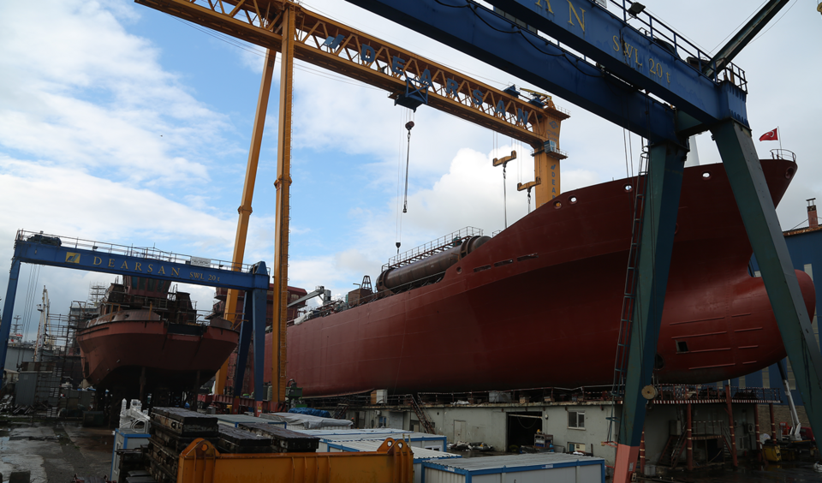
Yet another requirements classification
Solution
Business
Architecture
Constraints from the what the company can deliver
  Key competencies
  Innovation strategy
  Capacity
  Reuse
Image: Ggordi 2020 under CC-AS4.0
Notes:
Business requirements constrain what a company can deliver. This is the chance for requirements engineers to interact with strategic management and innovations management: where is the company good at? where does it want to improve? what are the company’s limitation?
In the example of our cargo ship, these are the constraints we as a shipyard have to impose ourselves. We cannot build longer than our slipways. Unfortunately, this class of requirements is rarely written down; instead, its kept implicit in informal knowledge “everybody knows our slipway is 250 m long” – but this is crucial information for new engineers!
The good news is that this class of requirements can be made explicit at any time. No need for time-pressure when eliciting solution requirements. When explicit, it neatly ties into engineering, manufacturing, innovation management and strategic (investment) management, but can also prevent sales from pursuing pseudo-opportunities “this project will be key, you engineers just make the oversized request work! Size is an implementation detail”
By making business requirements explicit, impossible requests can be spotted early on, using normal RM means.

Slide 12
Yet another requirements classification
Solution
Business
Architecture
System
Part
Part
Allocated and derived requirements
Internal interfaces
Best practices
Design choices
Notes:
Architectural requirements are requirements that originate from a specific architecture. These requirements emerge during the design while architecting the system. Typical examples are requirements allocated from system level to a specific part; or requirements derived from the design; or the interface requirements between these parts.
To continue our example of a container ship, a solution requirement might state that the ship shall have an automated on-board telephony system. When designing that telephony system and selecting the necessary components, the protocols and voice-encoding codecs between the components suddenly need to match – else the components will not work together. We need such requirements. But no customer or regulator or somebody else should interfere with our design decisions. So they cannot be requirements that any customer or external approved. That’s why I propose to treat them as a class of their own.

Slide 13
Considerations
Does solution, business and architecture classification lead to just additional categories?
NO
Each class can have functional, environmental, interface, etc. requirements
Handling is different
Notes:
Having presented my proposal, let‘s spend some minutes discussing its merits and drawbacks.
The first question to ask is “doesn’t this classification lead to just additional classes”? “Can’t we just extend our existing classes”?
My clear answer is No. Because within SR, BR and AR, each “conventional” class can be present. There are interface requirements in SR, BR and AR. Moreover, handling of SR, BR and AR is different…

Slide 14
Considerations
Each proposed class should be handled and managed in a tailored way
 | Solution | Business | Architecture
Source | External | Company | Project team
Scope | Solution | Many solutions | Solution design
Elicitation time | Project definition | Anytime | Design phase
Verification | Explicit | Implicit | Internal
Agility | Hindering | Neutral | Beneficial
Conflict resolution | Stakeholder negotiation | Management agreement | Chief engineer decision
Notes:
… as you can see here.
The source of the requirements is different, their scope is different, the time when we elicit them is different, the scope of verification is different, the impact of agile engineering is different, and the way we resolve conflicting requirements is different.

Slide 15
Considerations
Are Business Requirements really Business Requirements?
Our customer’s business
requirements are not our
business requirements
Customer‘s view
Solution
Business
Architecture
Solution
Business
Architecture
Notes:
…

Slide 16
Considerations
Alternatives to YARC
Explicit source tracking (e.g. stakeholders, laws & regulations, business, architecture)
Copy-paste for business requirements and V-model
Rely on requirements management
Struggle with change management
Notes:
Clearly, this proposed classification is not the only way how to classify requirements. Until now, SE and RM managed to work just fine even without this classification. So, it‘s worth to consider alternatives. Here are some that came to my mind.
Instead of having SR, BM and AR, we could track the specific source, and handle requirements accordingly. This may make RM more complicated, but with highly heterogenous stakeholder, it might even be better. But if we don’t go the full way, I think the YARC-classification is often a good compromise.
Alternatively, we might elicit SR, but simply copy-paste BR and use the V-model (or any other hierarchical model) to handle AR. In many cases, that’s sufficient. But we lose the ability to manage requirements in time, and to interact with innovations management and senior management on BR, so just keep that in your mind.
We might also decide not to use the YARC-classification explicitly, and jut rely on RM to manage requirements “appropriately”. In many projects, and with talented RMs, that may actually be sufficient in practice. But even then, I’d propose to keep the YARC-model in the back of your mind as a conceptual tool.
Finally, we might just struggle with inevitable changes. This happens so often, and I see it so often as a cause for project failure. Indeed, I argue today that considering the YARC-model will significantly reduce the struggles with changing requirements – but at the end, you do you.

Slide 17

Summary
Yet another requirements classification
Solution
  User value
  Functionality
  External interfaces
  Environment
  Laws and regulations
Business
  Constraints from the what the company can deliver
Architecture
Notes:
So to summarize, I propose to add another requirements classification, considering SR, BR and AR.
And with that, thank you for your attention.

Slide 18

Thank you for your attention

