Slide 1
Systems Engineering Education in the Age of Agentic AI:​
A Scenario-Based Outlook on relevant Systems Engineering Skills of the Future
September 21st 2026, Zurich, Switzerland
Swiss Systems Engineering Day (SwissED)
Dr.-Ing. Chantal Sinnwell, Dr-Ing. Michael Bitzer
Siemens Digital Industries Software
Notes:
Spannungsbogen: Siemens → Einordnung → Vision → Building Blocks → Szenarios → Fazit
A) 3 min: Introduction of Siemens and AI-Focus
B) 4 min: Imagine: „Fancy Vision“ for the Future of AI-based Systems Engineering
C) 2 min: Building Blocks for Szenarios
D) Scenarios: each with description, refence to building block, implication for SE-education, Siemens means and activities
D1) 3 min: Scenario 1: From Tools to Dialogue: Lowering Barriers in Systems Engineering
D2) 3 min: Scenario 2: From Creation to Validation: Working with AI-Generated Artifacts
D3) 3 min: Scenario 3: From Execution to Oversight: Governing Delegated Complexity
E) 1 min: Conclusion & outlook
F) 1 min: Q&A

Slide 2
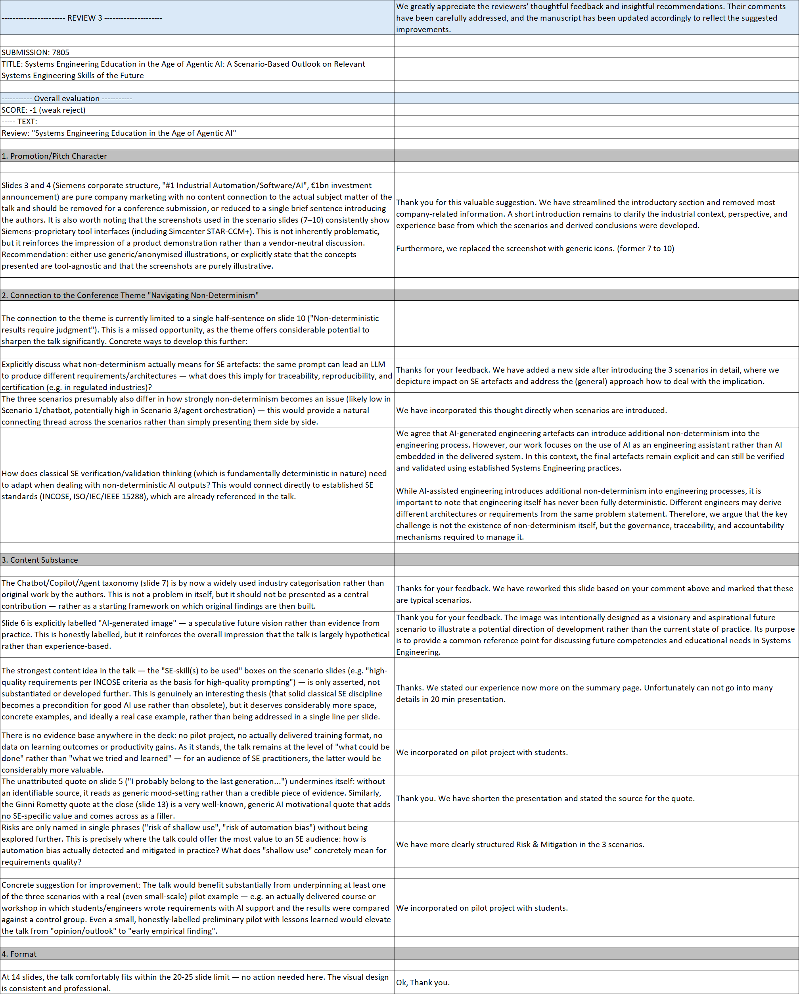
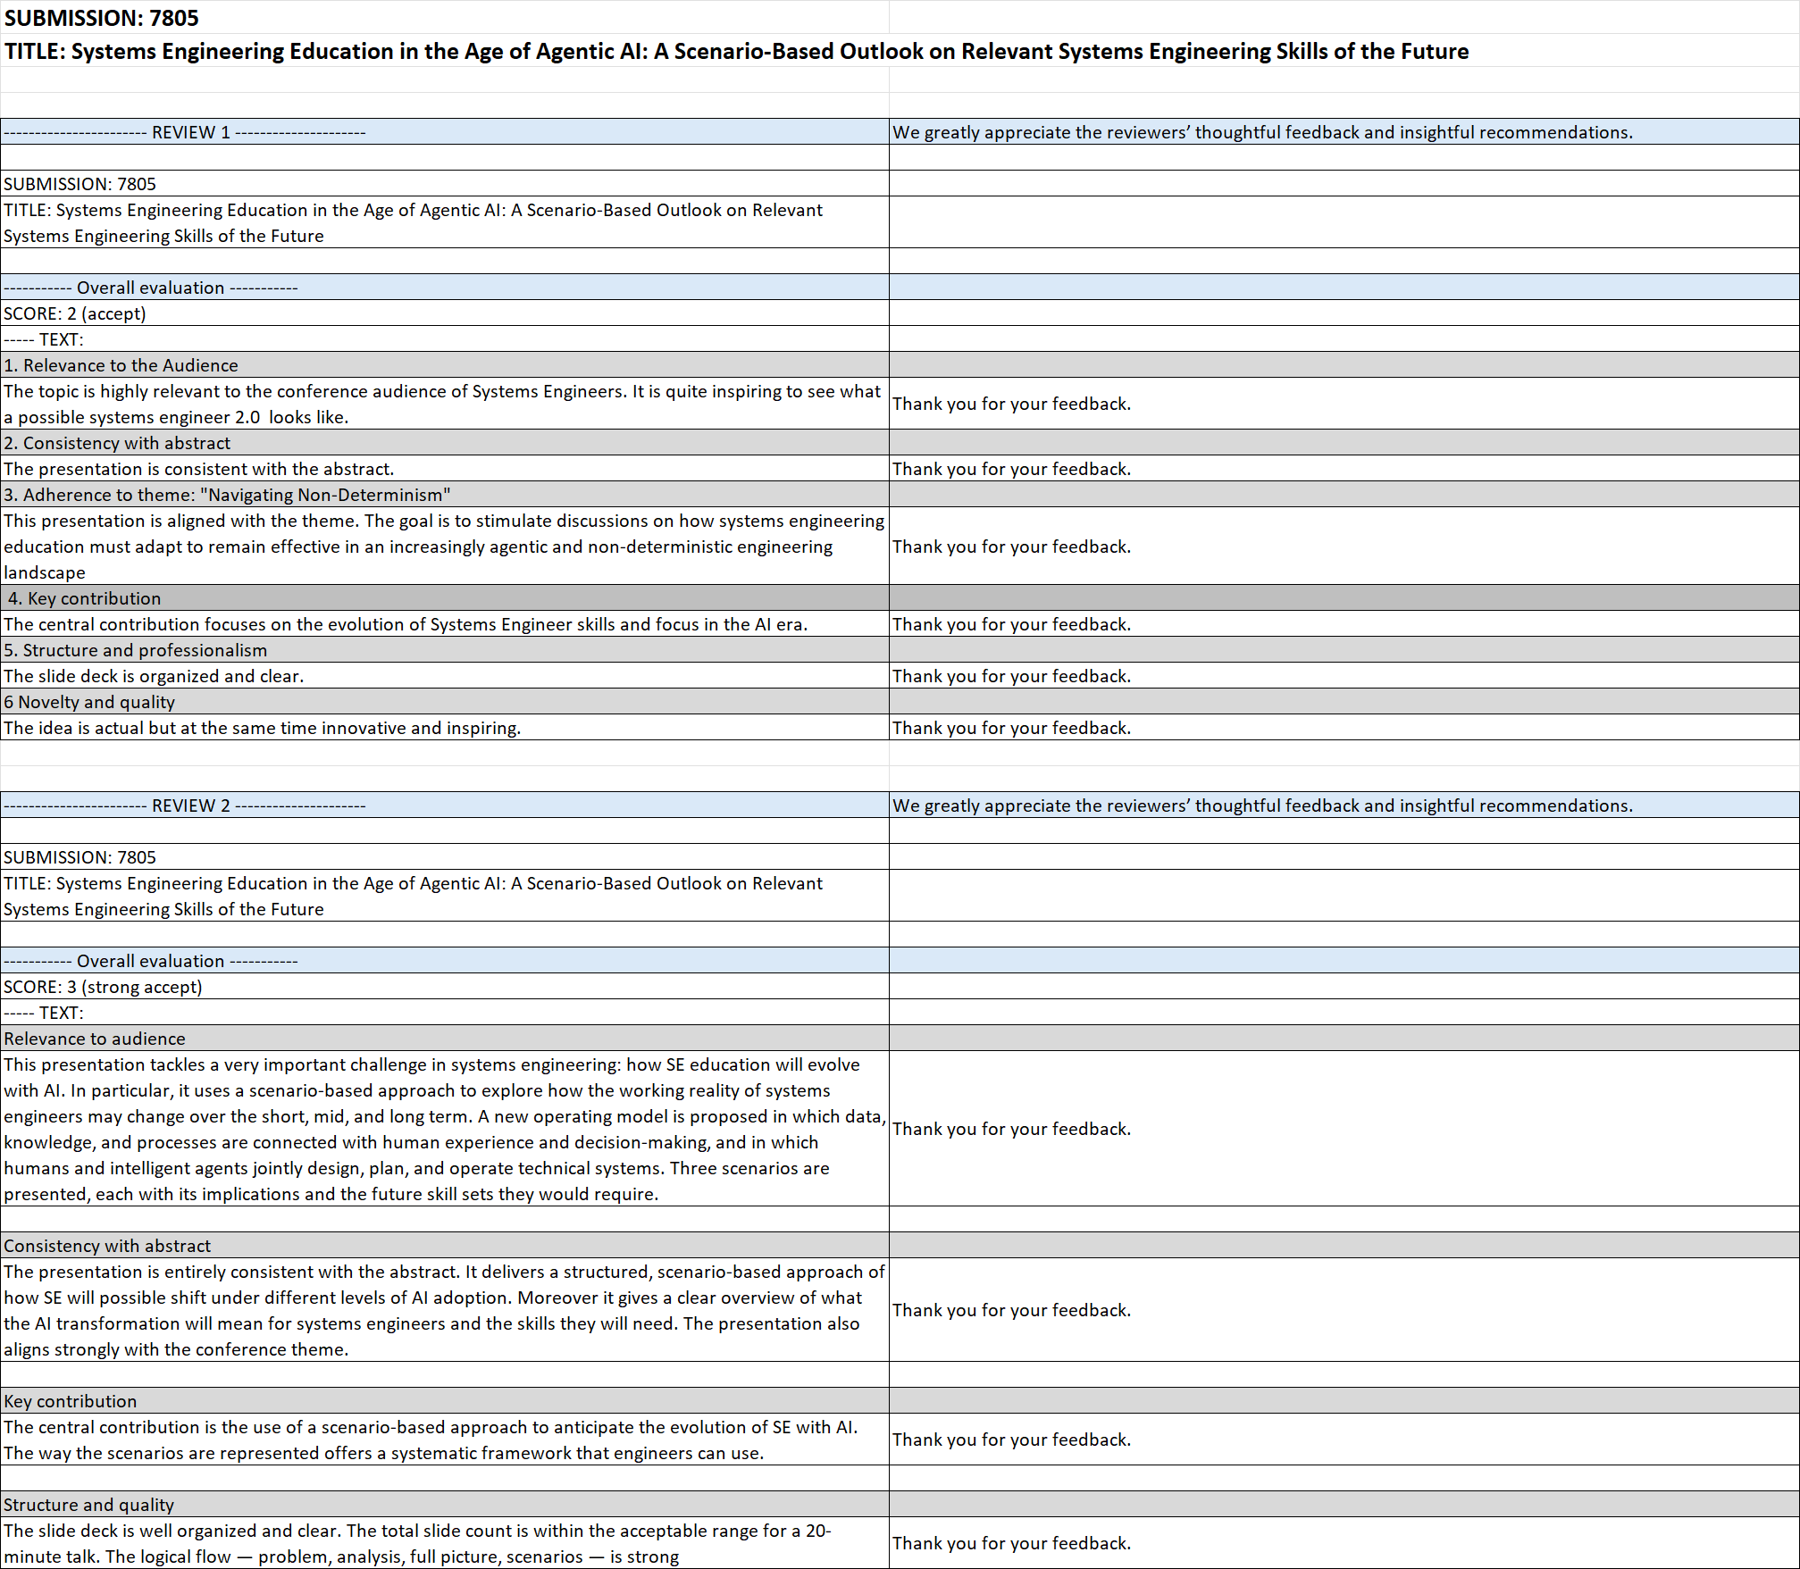
Reviewer Feedback - incorporated

Slide 3

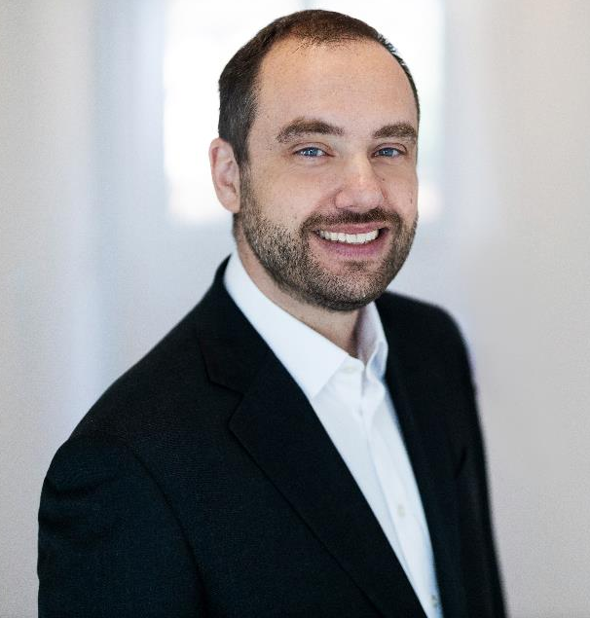
Authors
Dr.-Ing. Chantal Sinnwell
Domain Lead Systems Engineering
Siemens Digital Industry Software
Chantal.Sinnwell@siemens.com
+49 172 69 27 550
Dr.-Ing. Michael Bitzer
Head of Science, Academics & Transfer
Siemens Digital Industry Software
Michael.Bitzer@siemens.com
+49 152 59 200 772

Slide 4
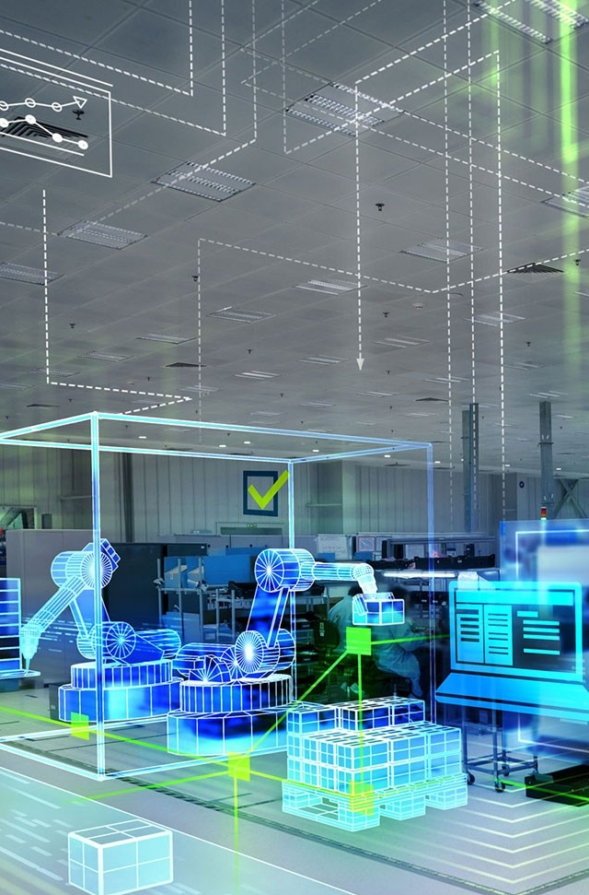

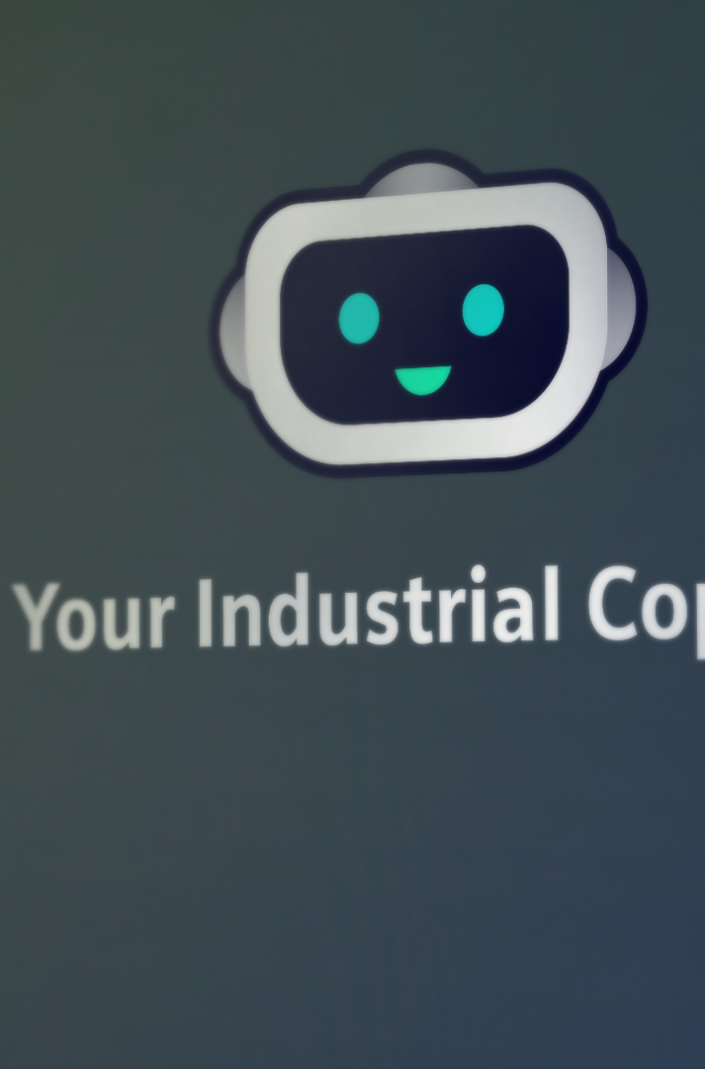
SIEMENS
#1 Industrial Automation
SIEMENS
#1 Industrial Software
SIEMENS
#1 Industrial AI
One in three machines worldwide contains a Siemens controller
92% of the Fortune 500 industrial companies use our software tools
1400+ AI experts
500+ AI patents
50+ years of AI innovation
“1b€ ”
invest in AI over
the next 3 years

Slide 5

„I probably belong to the last generation of managers who have exclusively led people. The generation currently taking on leadership responsibilities will be managing a mix of humans and AI agents.“
Roland Bush, CEO Siemens, 2026

Slide 6
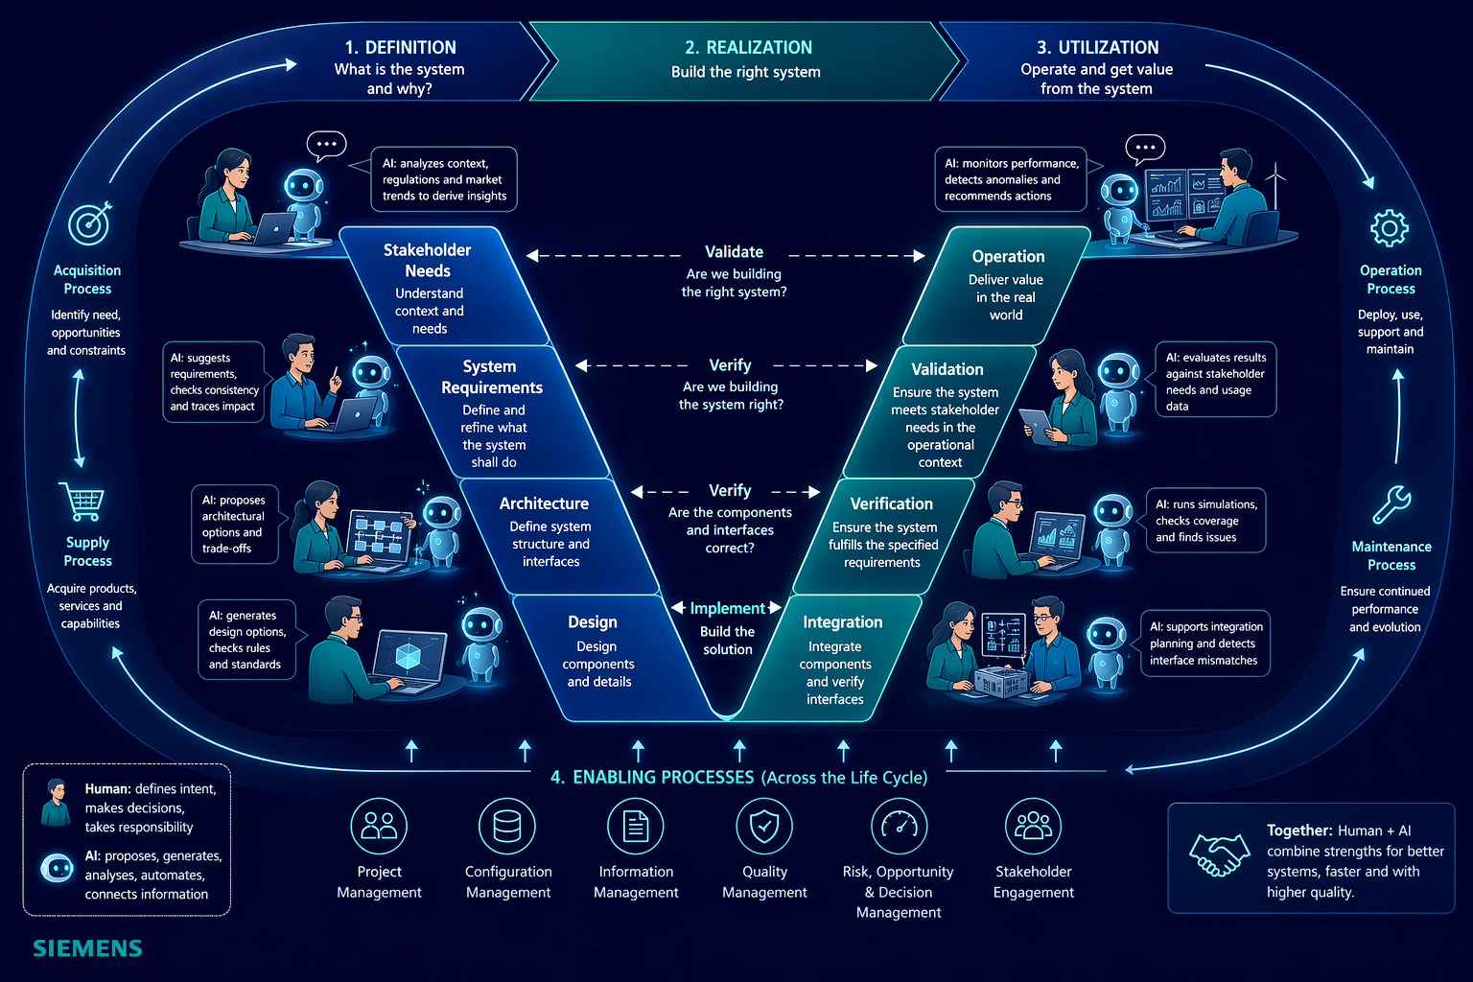
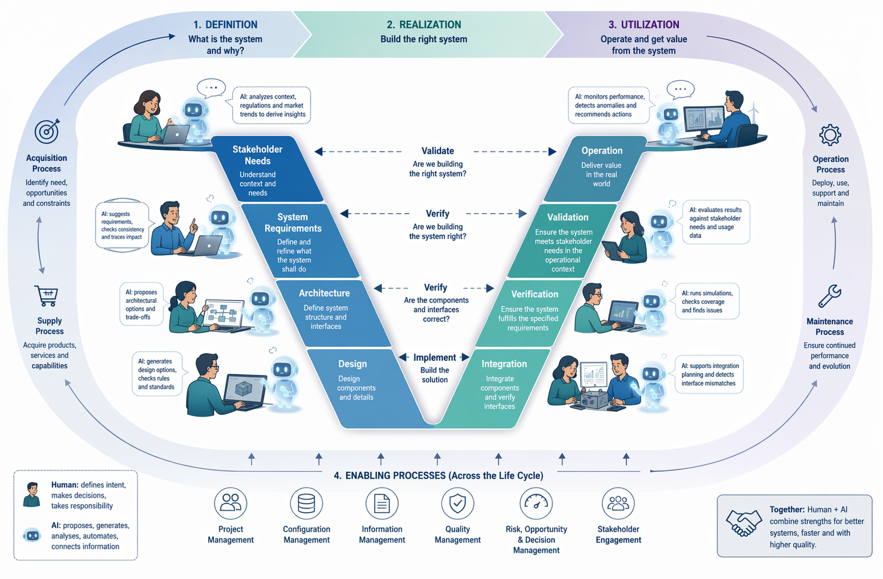

How could such a future look like? Imagine …
AI-generated image
Page 6
Optimization
Product Design
Manufacturing
Industrialization
Notes:
Vision Story (Speaker Script):
But what could such a future actually look like…
a future in which systems engineers and artificial intelligences work hand in hand as part of the same team?
Let’s imagine for a moment… that we are no longer in the year 2026… …but a few years ahead of today.
And let’s take a look together at the everyday work of a systems engineer…
In this future, the systems engineer does not start with tools… but with intent.
What is the goal? - What problem needs to be solved? - What are the constraints?
Based on that, a set of AI-based capabilities begins to support the work – across the entire V-model.
In early phases, AI helps to explore solution spaces… to suggest initial requirements and architectures.
During system design, it supports the refinement of models… checks consistency… and highlights trade-offs.
And further downstream, it continuously verifies and validates – simulating system behaviour and propagating changes across connected artefacts.
The engineer does not manually move from tool to tool anymore… but works in a continuous interaction with this evolving system of models, data, and generated insights.
Tasks are no longer executed step by step… but collaboratively – between humans and AI.
The human defines intent, makes decisions, and takes responsibility.
The AI proposes, generates, analyses, and connects.
But this also means that results are no longer fully predictable.
They are suggested, derived, and influenced by AI systems – requiring continuous evaluation and judgement.
And as a consequence, the role of the systems engineer shifts.
From creating everything manually… to guiding, evaluating, and integrating results across the lifecycle.
And from working in isolated tools… to collaborating in hybrid teams – consisting of humans and AI agents.
Conclusion:
What I have just described could be one possible future.
A future in which many purpose-specific AI tools interact – and where something new emerges from this:
A new operating model.
A model in which data, knowledge, and processes are connected with human experience and decision-making – and in which humans and intelligent agents jointly design, plan, and operate technical systems.
And this transformation… and the question of what it means for systems engineers with their future skillsets… is exactly what I would like to explore with you today.

Slide 7
Leveraging large language models (LLM) to improve productivity
Building Blocks of the future vision | 3 Typical Scenarios
Interaction / Prompting
e.g. Chatbot
Assistance / Automation
e.g. Copilots
Delegation / Orchestration
e.g. Agents
GOVERNED SPACE
1
2
3
4
INTENT
RULES
5
QUALITY
TRACE
DECIDE
SET THE FRAME
Prompt…
AI ORCHESTRATES & EXECUTES
REVIEW / VALIDATE / DECIDE
FRAME / DELEGATE / GOVERN
Find relevant answers faster
Quickly train new users and expand knowledge
Copilots acting on behalf of the user
Plan and iterate to complete complex tasks.
Agents can collaborate with humans and other agents (multi-agent frameworks) to accomplish these tasks.
Impact of Non-determinism
Lower probability
Higher probability
Notes:
A Large Language Model (LLM) is an advanced AI system trained on massive datasets to understand and generate human-like text. LLMs use deep learning techniques, particularly transformers, to process and predict language patterns.
Three aspects of using LLM in our solutions are related to:
Chatbot to find relevant information faster
Copilot: interaction between the chatbot and the simulation tool: it goes beyond simple responses by acting as an intelligent assistant that enhances productivity
An agent is more autonomous and goal-driven, capable of reasoning, making decisions, and executing complex tasks with minimal user
Scenario 1 – Interaction / Prompting
“From Tools to Dialogue: Prompt-Based Systems Engineering”
(optional Variante mit Deinem zweiten Aspekt):
→ “From Tools to Dialogue: Lowering Barriers in Systems Engineering”
Scenario 2 – Assistance / Automation
“From Creation to Validation: Working with AI-Generated Artifacts”
Scenario 3 – Delegation / Orchestration
“From Execution to Oversight: Systems Engineering with Autonomous Agents”
(optional Variante mit Deinem anderen Favoriten):
→ “From Execution to Oversight: Governing Delegated Complexity”

Slide 8
Scenario 1: From Tools to Dialogue: Lowering Barriers in Systems Engineering
Description
Natural language replaces complex user interfaces
AI lowers barriers to access and usage
Engineers still create, AI assists
AI focused on retrieval and consolidation of data
Implications
Less tool expertise required; Faster onboarding
Focus on problem framing & prompting
Risk: of shallow use
Mitigation: Apply established SE quality criteria to review AI-generated artefacts before adoption
Prompt…
Educations means
Teach prompting & AI interaction
Strengthen systems thinking
Use AI to accelerate learning
SE-skill(s) to be used in that context:
Writing high quality requirements or use cases according to INCOSE criteria
→ Basis for high-quality prompting

Slide 9
Scenario 2: From Creation to Validation: Working with AI-Generated Artifacts
Description
AI generates requirements, architectures, analyses
Engineers work and decide on AI proposals
Iterative human–AI refinement
Implications
Shift from creation to validation
Critical thinking becomes key
Risk: automation bias
Mitigation: Maintain independent engineering judgment through systematic review and validation.
QUALITY
TRACE
DECIDE
REVIEW / VALIDATE / DECIDE
Educations means
Train review & validation skills
Deepen domain understanding
Focus on quality & traceability
SE-skill(s) to be used in that context:
Defining clear criteria for good SE artifacts and outcomes
→ Basis for informed reviews and decisions

Slide 10
Scenario 3: From Execution to Oversight: Governing Delegated Complexity
Description
AI orchestrates end-to-end workflows
Multi-agent systems execute tasks
Engineers define intent & constraints
GOVERNED SPACE
1
2
Implications
Role shifts to governance & integration, Hybrid human–AI teams
Non-deterministic results require judgment
Risk: Loss of traceability and oversight.
Mitigation: governance, traceability, and human oversight.
3
4
INTENT
RULES
5
SET THE FRAME
AI ORCHESTRATES & EXECUTES
FRAME / DELEGATE / GOVERN
Educations means
Teach AI workflow orchestration
Build decision & responsibility skills
Strengthen socio-technical thinking
SE-skill(s) to be used in that context:
Clear framing of problem space and solution space
→ Basis to architect human-AI-network purpose-driven

Slide 11
"Navigating Non-Determinism: The New Engineering Reality"
Impact on SE artefacts drives the need for future skills
Interaction / Prompting
e.g. Chatbot
Assistance / Automation
e.g. Copilots
Delegation / Orchestration
e.g. Agents
GOVERNED SPACE
1
2
3
4
INTENT
RULES
5
QUALITY
TRACE
DECIDE
SET THE FRAME
Prompt…
AI ORCHESTRATES & EXECUTES
REVIEW / VALIDATE / DECIDE
FRAME / DELEGATE / GOVERN
Non-determinism means: The same engineering question may lead to different AI-generated answers, requiring engineers to critically assess relevance and completeness.
Non-determinism means: Multiple valid AI-generated solutions require systematic validation against engineering criteria.
Non-determinism means: Engineers can no longer control every step of execution but must govern acceptable outcomes and decision boundaries.
Future Systems Engineers must not eliminate non-determinism but learn to govern it. As in Systems Engineering today, the objective is not complete transparency of every decision, but confidence in the resulting system outcomes.

Slide 12
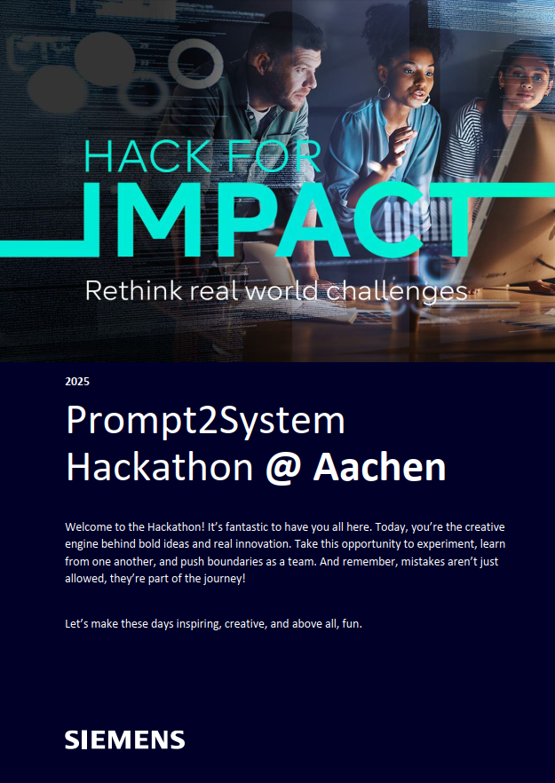

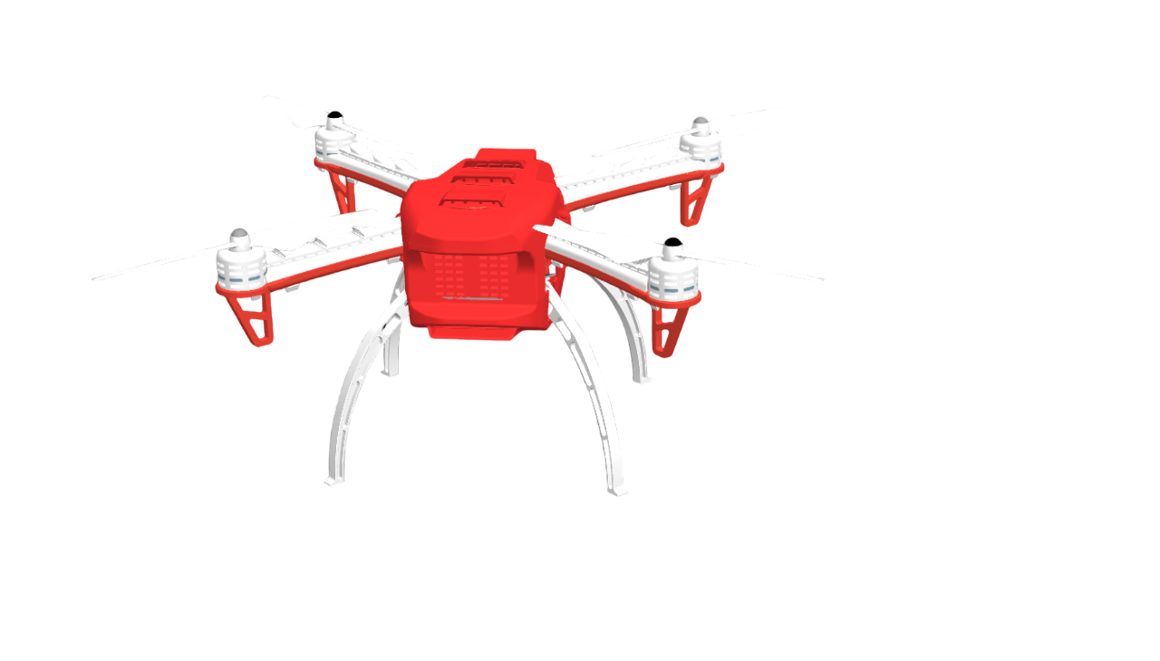


Pilot Project for Scenario 1
Student Workshop
Student Workshop
AI-support: SE Architecture
Lessons Learned
  The Challenge:
  “Use publicly available AI tools to design the system architecture of a mechatronic system.
  Document your journey: which prompts you used, how the models responded, and what differences emerged across platforms.
  The key deliverable is not only the architecture itself, but your prompting strategy and the insights gained on applying AI in systems engineering.”
  High-quality prompts led to high-quality architectures.
  AI accelerated architecture exploration and generation.
  Engineering judgment remained essential for validation.

Slide 13
Summary: Implications & Impact on Education
Implications
Shift from execution to supervision: engineers guide, evaluate, and decide
Increasing need for critical judgment in non-deterministic, AI-driven results
Growing importance of collaboration in hybrid human–AI teams
Impact on Education
Focus shifts to prompting, validation, and orchestration skills
Stronger emphasis on critical thinking and domain depth and overview
Continuous, AI-supported and faster learning journeys
AI does not replace core Systems Engineering competencies: high-quality requirements, systems thinking, and engineering judgment become even more critical for effectively guiding, validating, and governing AI-assisted engineering.

Slide 14

Thank you for your attention.

